Slide 1
2021-1 IMP AR PROJECT
AR INDIAN POKER
TEAM 5
Song Jihye, Jang Yoona, Kim Yejin, Kim Gyeongjin

Slide 2
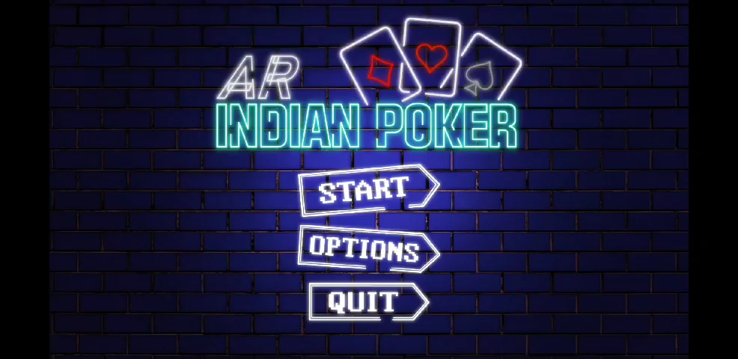
Play Video

Slide 3


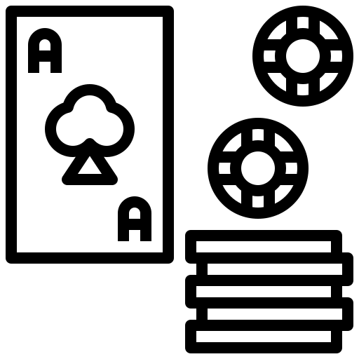

Project Introduction
Motivations
+
▶
Normal card / board games
cannot be played
without supplies
AR has good advantages
of showing
non-existent objects virtually
Use AR to enjoy the game
without any supplies
Especially, Indian Poker Game

Slide 4
Project Introduction
Details
Individual competition Indian Poker Game with AR system
Classification
AR Game application
Unity Version
2020.2.7f1
Platform
AR Foundation, AR Core
Target Device
Android
Tracking
Marker-based & Markerless

Slide 5




Work Division
Song Jihye
-
UI
Jang Yoona
-
AR Feature
Kim Yejin
-
GamePlay
Kim Gyeongjin
-
Gameplay

Slide 6
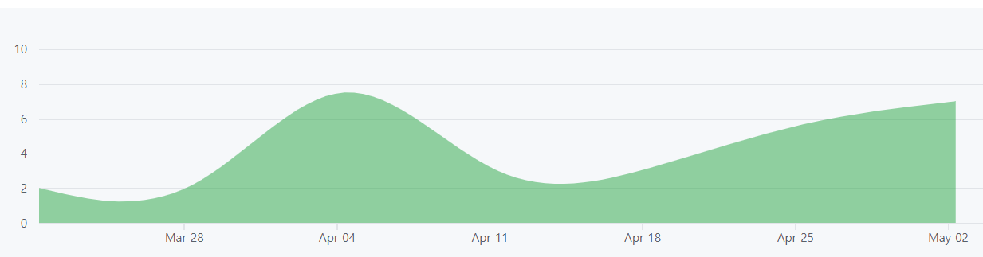
Project progress
Plan
-3/19 | | Idea pitch, first plan
3/20 - 3/26 | | Scenario
3/27 - 4/2 | | basic features (image tracking, basic UI)
4/3 - 4/9 | | First prototype
4/10 - 4/16 | | Discussion on Gameplay
4/17 - 4/23 | | Detailed implementation of UI
4/24 - 4/29 | | Detailed implementation of gameplay
4/30 | | Final presentation
5/1 - 5/5 | | Complement, Trailer Video

Slide 7




Project progress
Tool

Slide 8
Major Features
Main scene | menu list
GamePlay | situation ment, button
Betting chips
Spin ordering arrow
System’s card appears
AR
setting
GUI
Scene
Selection
Image
Tracking
Plane
Tracking
3D content
interacting
AR project setup
Main Scene
GamePlay(Select card)
GamePlay2(Competition)
Making game board

Slide 9


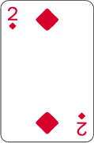
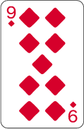
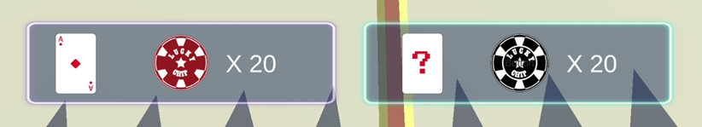
How to play
Act as is you have a card with bigger number on it.
Try to get counterpart’s chips as much as you can by thinking
based on the other’s card number

Slide 10


System Architecture
▶
▶
MAIN
GAMEPLAY1
GAMEPLAY2
Start | change scene to
gameplay1
Option | setting ( sound..etc)
Quit | exit app
Game intro ment
Touch arrow to betting order
Use image tracking to check
com’s card
Change scene to gameplay2
Plane detection to make
game board
Betting chips
Decide game result

Slide 11

Description Component
Main Scene
Start button
- Using SceneManager Loadscene to change
Gameplay scene
Option button
- setting options are enable
Quit button
- Application Quit

Slide 12
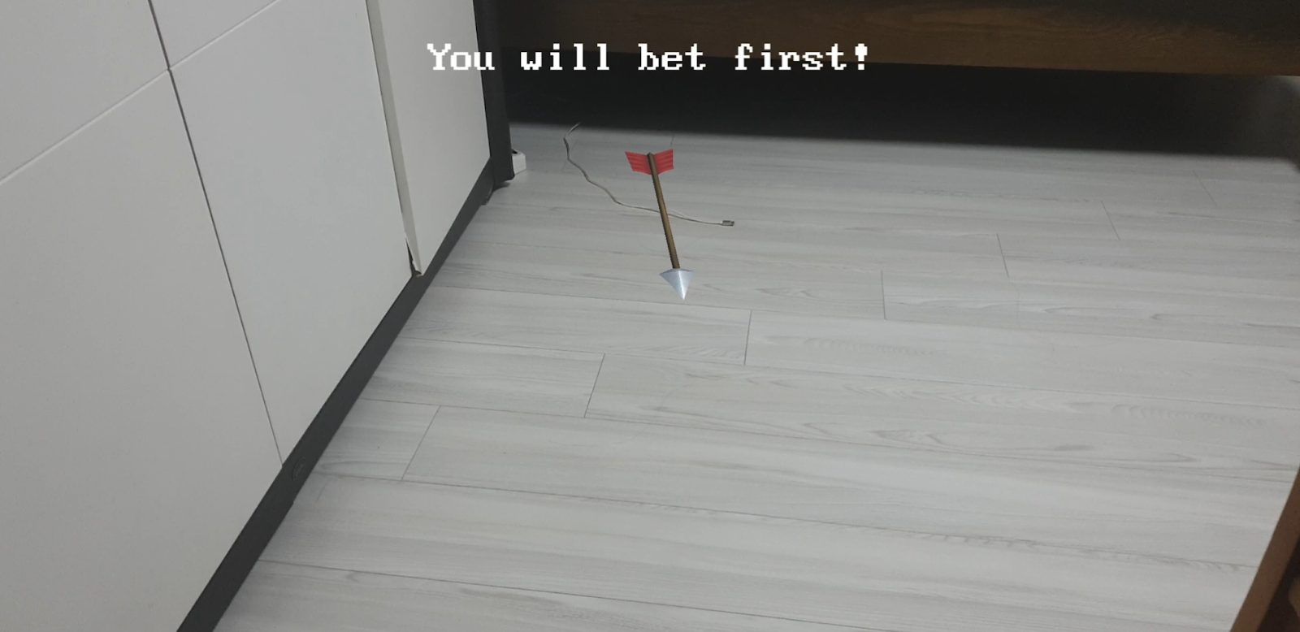
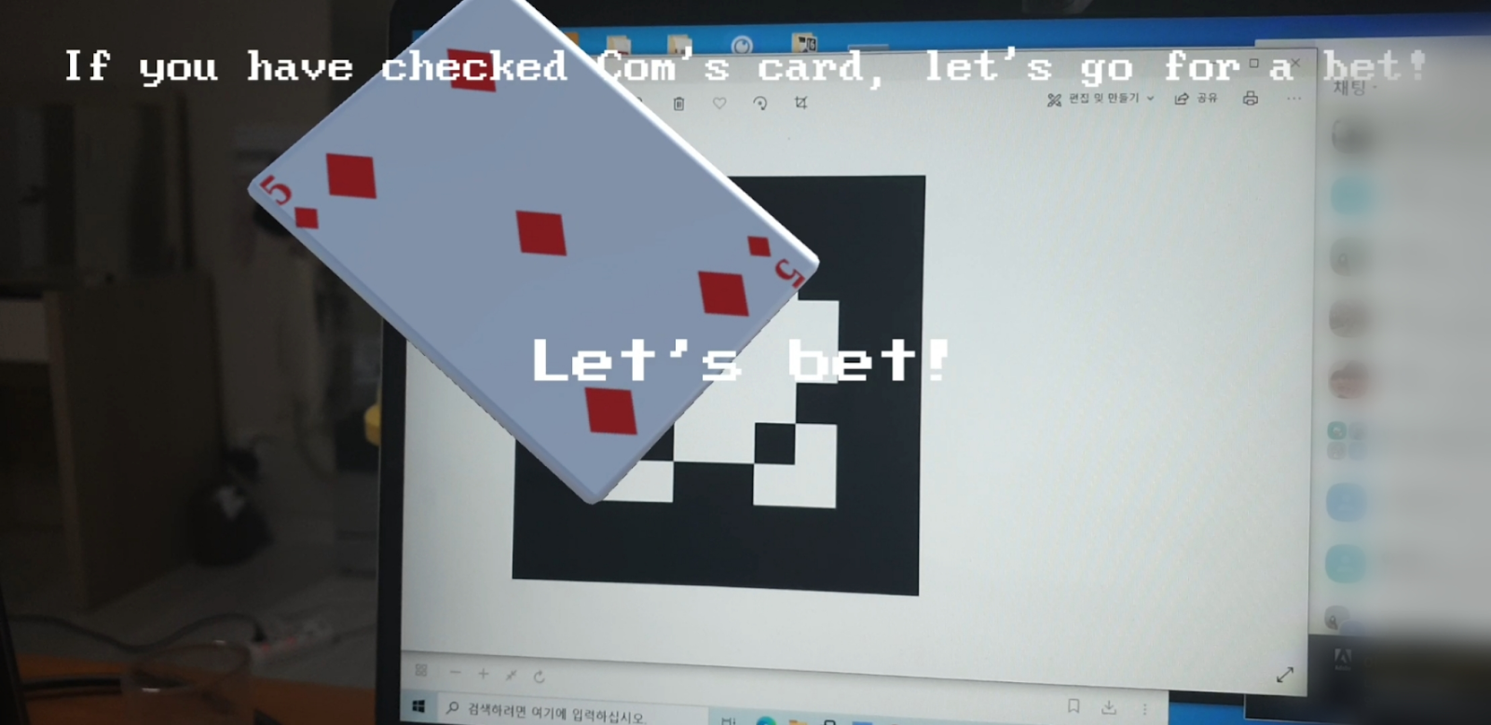
Description Component
GamePlay1
01 Decide the turn
Touch the rotating arrow and it stops rotating.
The person(or computer) in the direction of arrow
is pointing to goes first.
*Employed technique : 3D object interaction
02 Check the counterpart(computer)’s card
Once the marker is detected, a random card appears
on the marker
*A card is limited to diamond ace-10, total 10 cards
*Employed technique : marker-based image tracking

Slide 13
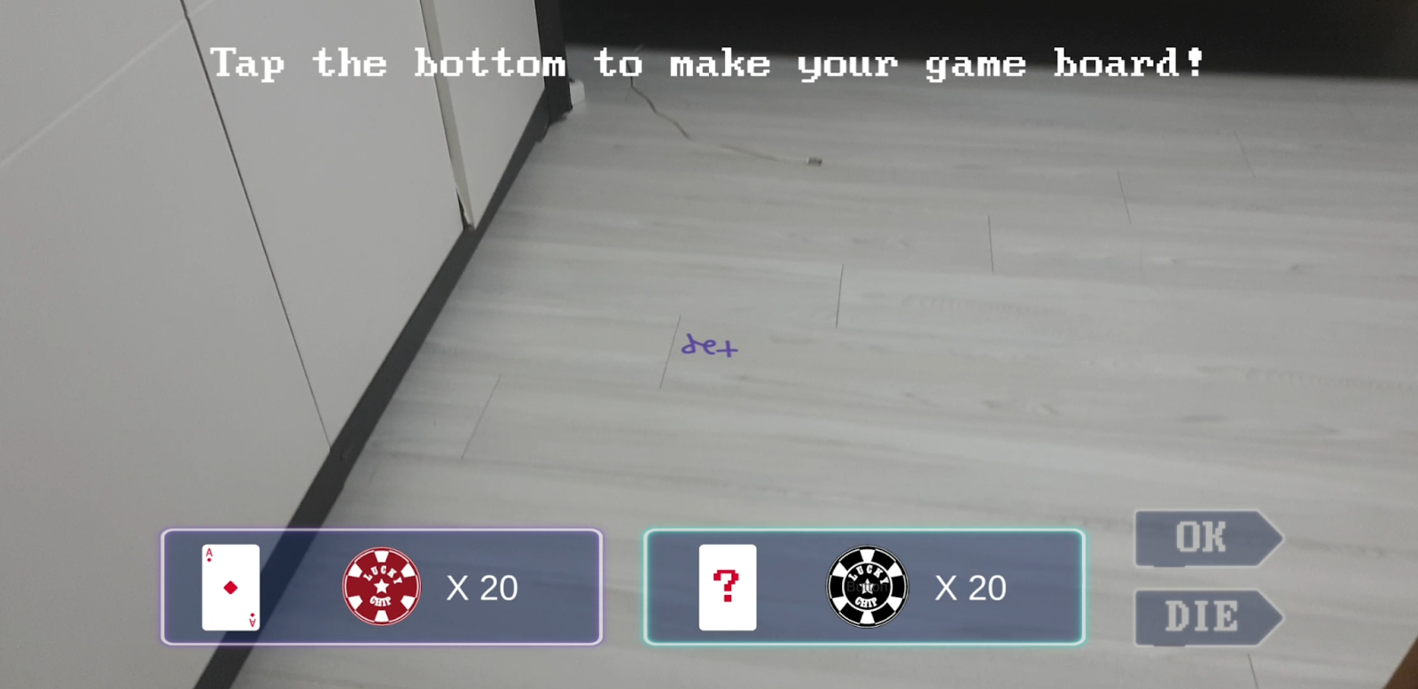
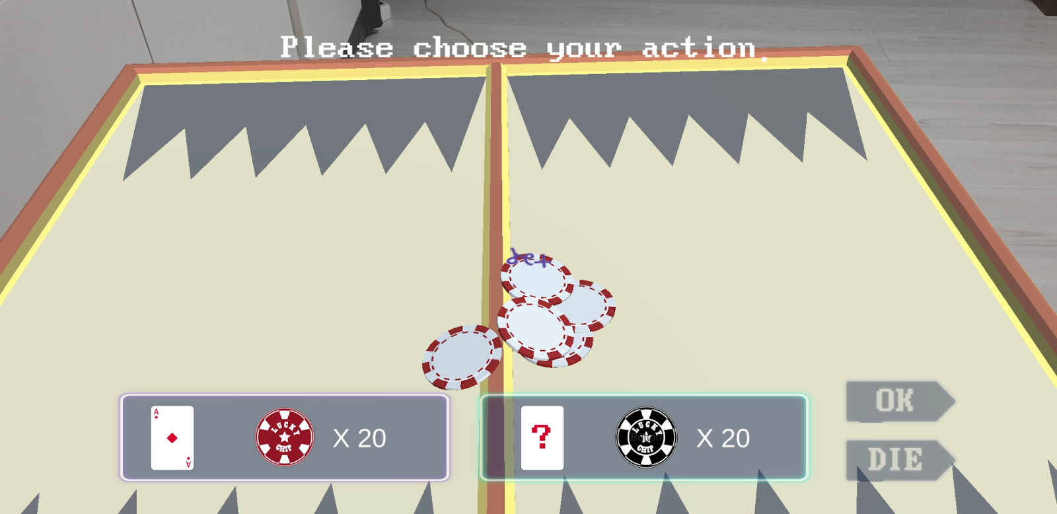
Description Component
GamePlay2
01 Set the gameboard
Indicator ‘tap’ appears on the plane after the plane is detected
If the indicator is touched, the gameboard is set
*Employed technique : plane tracking
02 Computer’s turn
Edit the win formula and make the computer system bet on it.

Slide 14
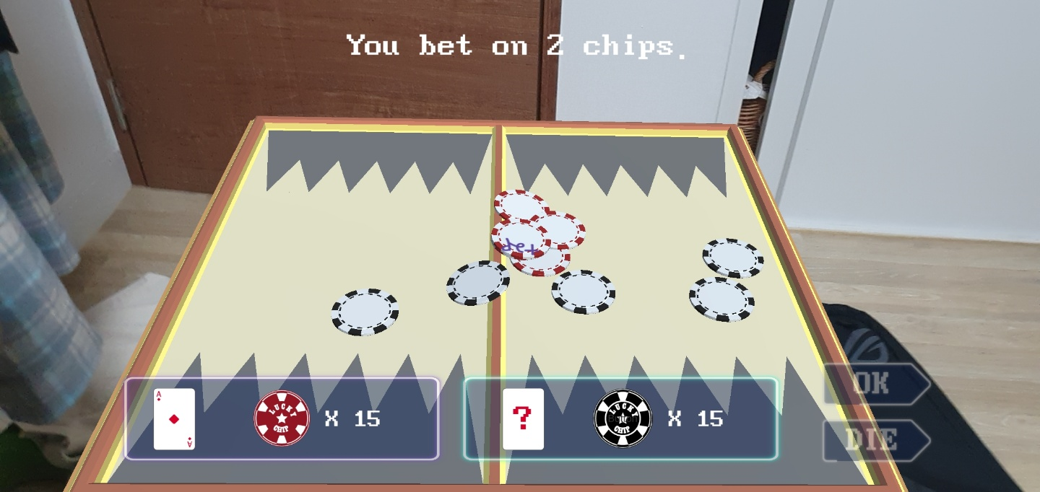
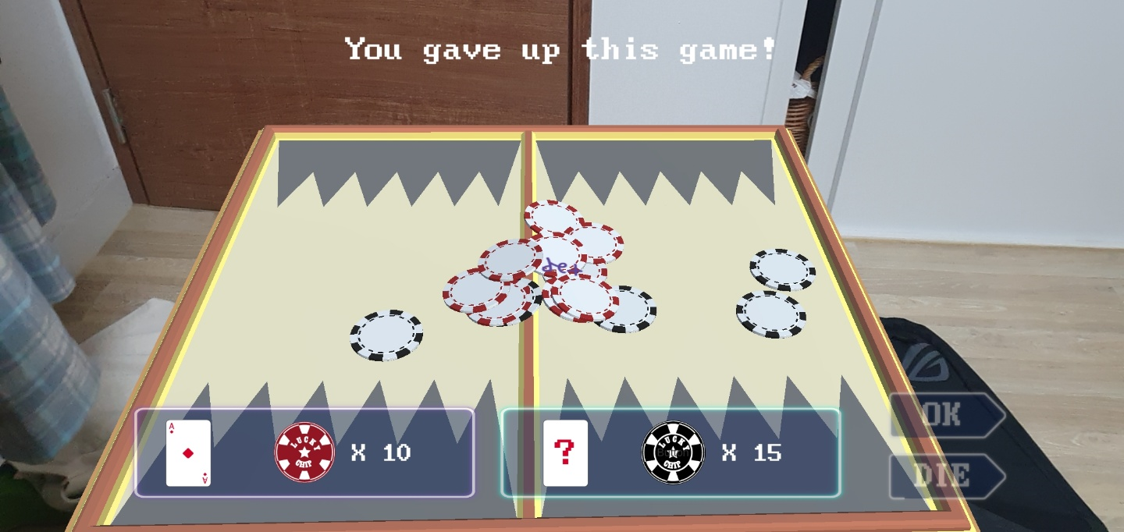
Description Component
GamePlay2
03 Player’s turn
Select the button ‘ok’ for betting, ‘die’ for giving up.
- Ok : Player can bet the chip on the game board by
tapping it.
Should bet more than the counterpart’s chips
and less than 20 chips.
- Die : the counterpart wins

Slide 15
Requirements Check
Interactive application that responds to user input
Touching arrow, spawning a board and chips
Have a reason for using AR
We can play game anywhere without game supplies by using AR
Allow the user to use marker-based or markerless
It supports both marker-based and markerless(plane detection)
Have 3D content that can be interacted with
There is an arrow that can be interacted with users
Have GUI with scene selection, options, etc
Buttons(start, options, quit) in main scene,
texts(touching this enables users to move play scene2) in play scene1,
buttons(ok, die) during game play,
buttons(continue, quit) after the game is over

Slide 16
Requirements Check
Have music / sound effects
Every scene has different background music
Sound effects when touching buttons & objects appear
Built on the Android platform
AR Foundation, AR core
Github is used throughout the project
https://github.com/zogak/ARproject

Slide 17
Challenges
AR system supports only one object per marker
We wanted to connect list of different cards on one marker so that we can use those cards
by using only one marker. -> We used random material instead, connecting only one object
to one marker.
Computer AI logic
As we had not enough knowledge in machine learning, we just used probabilities for computer AI.
Saving the number of chips
We tried to come up with optimum ways to count the number of chips, so that the game
continues smoothly.
Information through scenes
By using DontDestroyOnLoad, we kept information through whole scenes.

Slide 18


References
free little games asset pack (unity asset store)
Cartoon weapon pack (unity asset store)
Board games (unity asset store)
| 3D OBJECTS |
Three Wise People (No Copyright Audio Library)
Chip Falling Sound (No Copyright Audio Library)
Entering Sound (No Copyright Audio Library)
Lazy Walk – Cheel (Youtube Free Audio)
Timpani Beat – Nana Kwabena (Youtube Free Audio)
| SOUNDS |

Slide 19
Thank you

